Slide 1



OVERVIEW OF HIV TESTING SITES CERTIFICATION PROGRAM IN COTE D’IVOIRE
REPUBLQUE DE CÔTED’IVOIRE
Union-Discipline-Travail
MINISTERE DE LA SANTE DE L’HYGIENE PUBLIQUE ET DE LA COUVERTURE MALADIE UNIVERSELLE
DE
OSSEY CHO INES PRISCA
Pharmacist Biologist, Certification program coordinator
MOH/NPHL
RTCQI best practise meeting, Cape Town, 06/06/2024

Slide 2
PLAN
INTRODUCTION
OBJECTIVES
METHODOLOGY
RESULTS
LESSONS LEARNED
BEST PRACTISE
WAY FORWARD
CONCLUSION

Slide 3
INTRODUCTION
The HTS Certification Program aggregates and continuously monitors all aspects of quality and Maintain the quality of HIV testing services on an ongoing basis
Certification of HIV testing sites and Provider competency assessment are implemented simultaneously
2015: Adoption by the MOH of Rapid test Continuous Quality Improvement Initiative (RT-CQI) with CDC –PEPFAR support
2016 to 2019: Implementation by a CDC funded partner ( ITECH)
2019: Implementation successfully transferred to MOH
2020 to now: Implementation by the LNSP (National Public Health Laboratory)

Slide 4
OBJECTIVES

Slide 5
OBJECTIVES
General: Continuously monitor all aspects of quality
Specific:
- Improve the accuracy and reliability of HIV diagnosis using rapid tests at the site level.
- Facilitate the implementation and maintenance of an effective quality management system
- Reassure customers who use the services

Slide 6
METHODOLOGY

Slide 7
CERTIFICATION PROGRAM FRAMEWORK
Definition of national standards and procedures
Coordination and supervision of program implementation
Preparation and dissemination of program report
Dissemination of certificates to providers
Completion of written evaluations
Performing direct observations
Carrying out external audits and developing an improvement plan
Writing and transmission of reports to the management of the structure, the sub-committees and the health district
National Certification committee:
CNCEC/LNSP
Auditors
Coachs
District/ IPs
Coaching of testers on quality and certification requirements
Conducting internal audits
Ensure the implementation of corrective measures and the improvement plan
Ensure that staff was trained in national HIV testing modules
Promote written assessments
Identification and proposal of eligible testers for certification
Audit Report Review

Slide 8
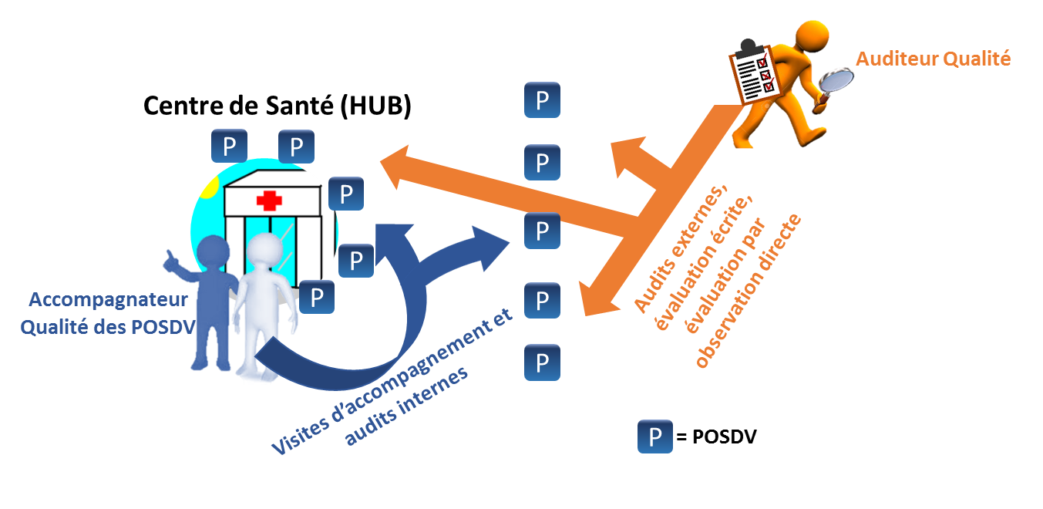
METHODOLOGY
1
4 main steps
HIV sites selection
Initial audit
Follow up audit/coaching
certification audit/recertification audit
4
2
3

Slide 9
METHODOLOGY
1- SITE SELECTION
2- INITIAL AUDIT:
3- FOLLOW UP AUDIT/COACHING
4- CERTIFICATION AUDIT
By: NPHL
≈250 HTS sites per year
Selection Criteria: Volume of tests, Clinical Ips…
By: National quality Coachs
For sites newly enrolled
Objective: Establish the baseline level
By: National quality Coachs
Sites level 0, 1, 2, 3 and sites which previously failed
Objectives :
Follow up audits: Identify non conformities and corrective actions, Assessing site level towards certification
-Twice a year
Coaching: Corrective action implementation, Providers capacity building
- During 03- 06 months
By: National Quality auditors
For sites level 4
Objectives: certification or recertification
Once a year
Recertification: Certified sites are monitored twice a year through audits.

Slide 10
ASSESSMENT TOOL
SPI-RT CHECKLIST
SECTIONS | NOM DE LA SECTION | SCORE
Section 1 | Training and providers competency assessment | 10
Section 2 | Infrastructure | 5
Section 3 | Biosafety/ Biosecurity | 11
Section 4 | Pre analytical phase | 12
Section 5 | Analytical phase | 6
Section 6 | Post analytical phase– documents and registers | 9
Section 7 | Proficiency testing | 8
TOTAL SCORE |  | 61
Niveaux | Score | Results
Niveau 0 | less than 40% | Need for improvement in all areas and immediate correction
Niveau 1 | 40% - 59% | Need for improvement in specific domains
Niveau 2 | 60% -79% | Partially eligible
Niveau 3 | 80% -89% | Close to certification
Niveau 4 | 90% or above | Eligible to certification

Slide 11
ELIGIBILITY CRITERIA
Any HTS site operational for at least one (01) year and with physical infrastructure
Obtained at least 90% in the audit with the SPI-RT checklist
Achieved a 100% score to the PT during the current year
2/3 or 100% (for HTS with one or two providers) of the providers are certified
Certification obtained for a period of 2 years

Slide 12
RESULTS 2022-2023

Slide 13
RESULTS
25/33 Health Régions
Participation rate for 2022-2023
90,45%
89,91%
91,79%
Reasons for non participation
HTS closed
Health facilities being renovated

Slide 14
RESULTS
Certification rate 2022-2023
Clinical HTS: Low certification rate
- Activity Transition from Ip to NPHL
- Challenges in implementing recommendations from the audit: biosafety (water, protective glasses) and lack of proof of training
Community HTS:
- Low success rate in 2022: first participation in the certification process
- Increased certification rate in 2023: high community commitment
44/58
67/144
105/217
61/159
11/67
78/209

Slide 15
RESULTS
2022 & 2023 results comparison
Slight increase in the number of participating sites as well as the number of certified sites from 2022 to 2023.
Strong community engagement in the process
Involvement of quality coaches with enhanced capacities.

Slide 16
RESULTS
Cumulative results for 2022 and 2023

Slide 17
LESSONS LEARNED
Maintain the certification of HTS sites on an ongoing and periodic basis
Ensure the involvement of the Regional, Departmental Health Services Directors in the implementation of the activity
Involve Clinical Ips in the implementation of audit recommendations
Ensure a periodic refresher of the pools of quality coaches and auditors
Ensure very good collaboration between all stakeholders.

Slide 18


BEST PRACTISE: Award ceremony
Award ceremony to present RTCQI results every year and recognize excellence
Participants: MOH leads, Region, Districts, CDC, /Ips/Quality Coaches/Quality Auditors/Service Providers....
Provision of Certification Certificates to certified testers and sites

Slide 19
WAY FORWARD
Overcome the difficulties related to the management of audit data by implementing electronic tools.
To have adequate human resources for the optimal management of databases resulting from electronic tools.
Decentralize the activity at the regional level to be more efficient.

Slide 20
CONCLUSION

Slide 21
CONCLUSION
The HTS sites certification program is a key component of the RTCQI. It has evolved from 2022 to 2023 in Cote d’Ivoire. For its effective implementation, it requires training and capacity building of key actors and perfect collaboration between all stakeholders.

Slide 22
ACKNOWLEDGEMENT
General Directorate for Health
LNSP staff
Coachs
Auditors
Districts, Regions, Health centers
Implementing partners
CDC

Slide 23

MERCI DE VOTRE ATTENTION

